Slide 1
Chapter: 1.4
Periodic table

Slide 2
The periodic table
The periodic table arranges the elements in order of increasing atomic number.
History of the PT
The first PT was developed by Dmitri Mendeleev in 1869 and was first able to be arranged in the current structure.

Slide 3
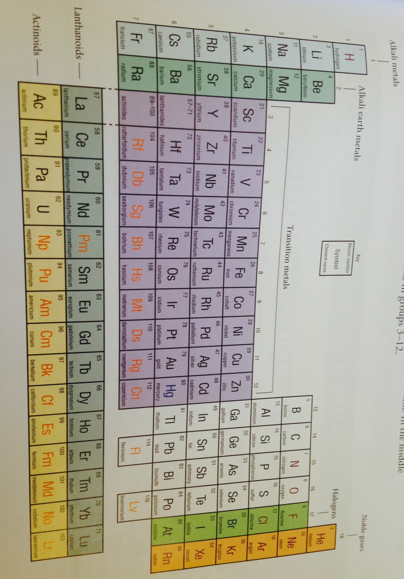

Slide 4
Arrangement of periodic table
The PT is arranged in a series of horizontal rows called periods vertical columns called groups.
Elements are in order of their atomic number from left to right in each row.
Group I is often referred to as the alkali metals. In the middle of the PT ( groups 3-12 ) are the transition elements.

Slide 5
Each of the elements in the same group shows similar chemical properties. E.g. during reaction with water, group I elements will form a metal hydroxide and hydrogen gas.
Na+ H₂O ➔ NaOH + H₂
The reactivity of the elements in group I increases down the group.
Metals appear on the LHS of the table, non-metals are on the RHS and metalloids are in a diagonal strip between them.
A metalloid is an element that has properties of both metals and non-metals. E.g. B, Si, Sb -----
Do Question set : 1.3, Q’s 1,4, 5 and 7

